Slide 1
Project Presentation of CO-OP Project at Industry (Module-2) (22CS421)
On
A Hybrid Explainable AI Framework for Cyber Threat Detection and Response
Yashika
2210992564
Supervised By
Dr. Preeti Saini
Department of Computer Science and Engineering,
Chitkara University, Punjab

Slide 2
Abstract
AI-based cybersecurity is increasingly necessary as businesses generate large volumes of data across endpoints, networks, clouds, and identity systems. Traditional signature-based and correlation-driven methods struggle with evolving attacks, encrypted traffic, and slow-moving threats. This research proposes an AI framework using supervised learning for known attacks, anomaly detection for unknown threats, and reinforcement learning for risk-based response. The system integrates multi-source data, temporal and graph-based modeling, and explainability through distillation and rule extraction. Testing shows a 9–14% F1-score improvement, 22–31% fewer false positives, 28% lower MTTR, and 17% less analyst effort. The findings show that layered, explainable, and continuously monitored AI can improve cybersecurity operations, provided safeguards such as drift monitoring, adversarial hardening, and human oversight are maintained.
2

Slide 3
Introduction
In the modern digital world, organizations heavily rely on connected devices, cloud computing, and internet-based applications. Consequently, a vast amount of data is constantly generated from diverse sources such as network traffic, endpoints, applications, cloud platforms, identity systems, and user interactions. This data is of significant importance in identifying potential security risks. Nevertheless, managing and processing such large-scale data is a major challenge for traditional security solutions.
Traditional security solutions such as intrusion detection systems and Security Information and Event Management (SIEM) solutions heavily rely on predefined rules, known attack signatures, and correlation logic. These approaches are effective for detecting known risks, but they are not efficient against unknown risks. Cyber attackers increasingly use sophisticated methods such as polymorphic viruses, encrypted communications, and low-and-slow attacks to evade traditional solutions.

Slide 4
Problem Statement
The cybersecurity landscape has shifted from traditional perimeter-based defense to continuous monitoring across enterprise networks, endpoints, cloud platforms, and user identities. This shift has significantly increased the volume, speed, and complexity of security telemetry. Traditional security tools that rely on signatures, rule-based detection, and manually tuned correlation engines are often unable to detect dynamic attack patterns, encrypted traffic, zero-day threats, and slow-moving attacks effectively.
A major operational challenge in modern security operations is the high volume of false-positive alerts generated by existing tools. Security analysts are frequently overwhelmed by large numbers of alerts, many of which do not represent actual threats. This leads to alert fatigue, reduced analyst efficiency, delayed investigation, and an increased risk of overlooking genuine attacks. Such delays in threat detection and response can result in data breaches, financial losses, operational disruption, and reputational damage.

Slide 5
Methodology
The methodology adopted in the research is based on the design of a hybrid AI-driven cybersecurity framework. The framework is intended to improve threat detection and response by combining supervised learning, unsupervised anomaly detection, reinforcement learning, and explainable AI. The methodology includes data collection, preprocessing, feature extraction, threat detection,response recommendation, explainability, and performance evaluation.
To overcome the shortcomings of existing systems, the research proposes a hybrid artificial intelligence system. The system uses several machine learning approaches to provide better detection and response. It is composed of three main elements. First, supervised learning is used for detecting known attacks. Second, unsupervised learning is used for detecting unknown attacks and abnormal behavior. Third, reinforcement learning is used for suggesting response actions based on the detected threat and the surrounding context risk.

Slide 6
The system collects data from various sources including network traffic, endpoint logs, cloud systems, identity information, and user activity data. The collected data is preprocessed to remove noise, handle missing values, and normalize values. Feature extraction is then applied to convert the raw data into useful representations. The processed data is supplied to machine learning algorithms for detection. After a threat is detected, the reinforcement learning component recommends a response. An explainability module provides understandable reasons for decisions so that analysts can validate the output.

Slide 7
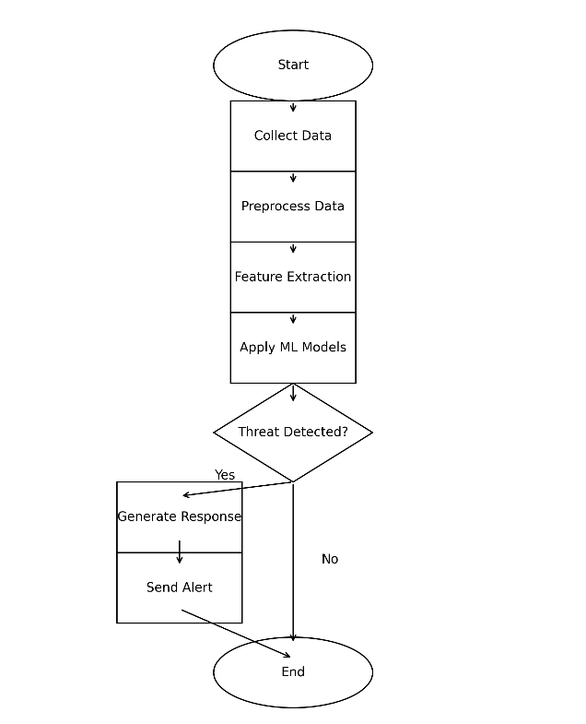

Slide 8
Tools and Technologies
The implementation of the proposed system is achieved using Python because Python provides flexibility and a rich ecosystem for machine learning, cybersecurity data processing, and experimentation. It supports libraries for data cleaning, model training, feature extraction, visualization, and evaluation.
TensorFlow and Scikit-learn are used for building and training machine learning models. Scikit-learn is suitable for supervised learning, unsupervised learning, data preprocessing, and metric evaluation. TensorFlow supports deep learning and scalable model training when more complex architectures are needed.
Supervised Learning is used for classifying known attacks and normal behavior using labelled data. Algorithms such as decision trees, random forest, support vector machines, and neural networks are relevant to this phase. Unsupervised Learning is used for identifying abnormal patterns and unknown threats without relying only on known signatures. Deep Learning is considered for complex large-scale data and automatic feature learning, although it may require higher computational resources and stronger explainability support. Reinforcement Learning is used for response recommendation through a trial-and-error learning approach and context-based risk assessment.

Slide 9
Implementation
The implementation begins with data input from benchmark datasets and simulated enterprise security sources, including both normal and malicious activities. The collected data is preprocessed by removing noise, correcting inconsistencies, handling missing values, and normalizing features to ensure that the detection models receive high-quality structured input. After preprocessing, a supervised learning model is trained using known attack categories and benign data to identify patterns associated with existing threats. At the same time, an unsupervised model is used to detect unusual behavior that deviates from normal activity, enabling the identification of unknown or zero-day attacks. This hybrid detection approach improves overall performance by addressing both known and unknown threats within a single framework. Once a threat is detected, reinforcement learning is applied to recommend suitable response actions based on the risk context. These actions may include blocking suspicious traffic, isolating an affected host, escalating the event, or prioritizing the alert for immediate investigation. To support analyst trust and faster decision-making, explainability is implemented through model distillation and rule extraction, which convert complex model behavior into understandable explanations.

Slide 10
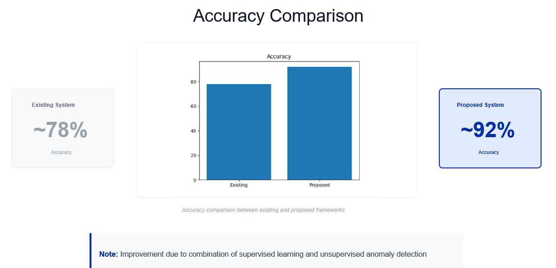
Results

Slide 11
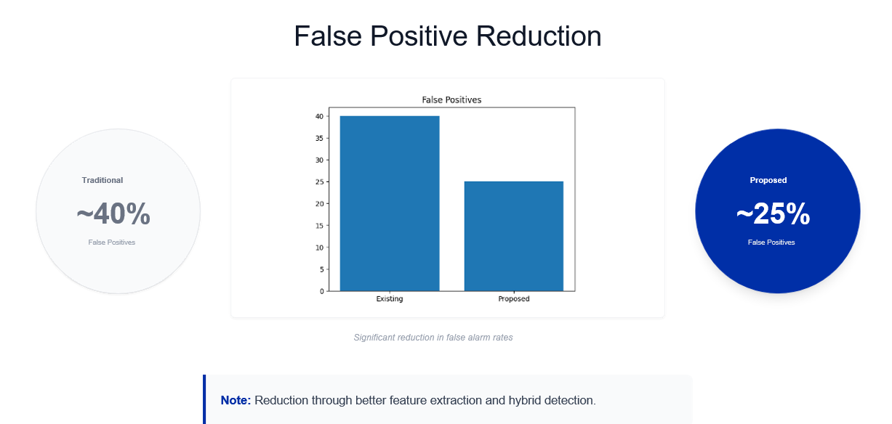
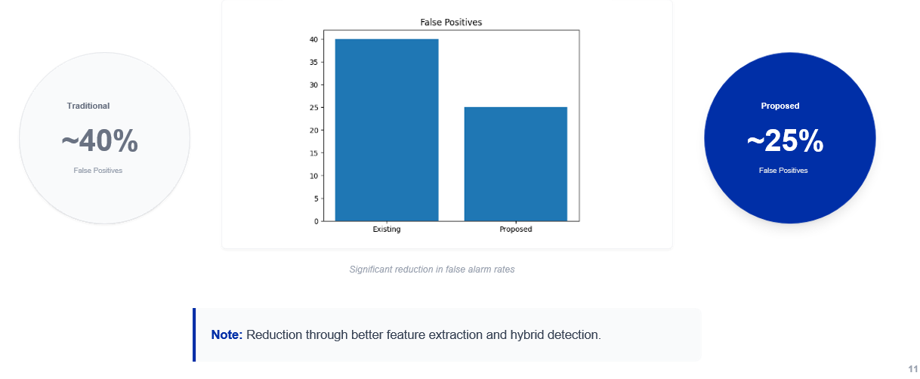
Results

Slide 12
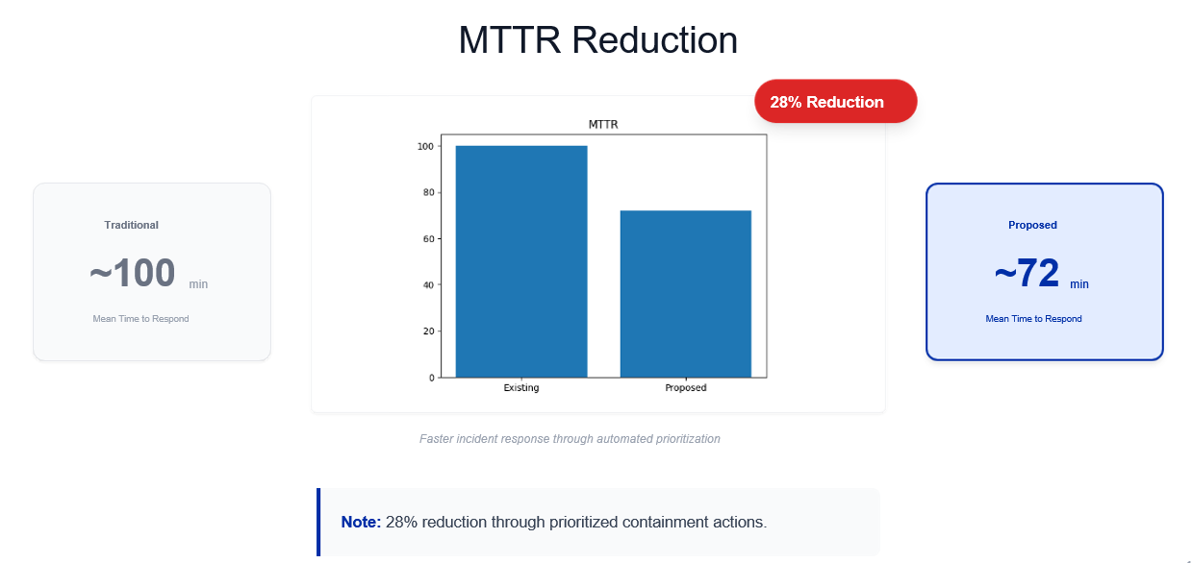
Results

Slide 13
Conclusion
Proposed AI-based cybersecurity system overcomes limitations of conventional threat detection.
Proposed AI-based cybersecurity system overcomes limitations of conventional threat detection.
Effective for both known and unknown cyber threats.
Includes explainability for analyst validation.
Results: Improved accuracy, reduced false positives, reduced MTTR, and reduced analyst effort.

Slide 14
Thank You
14

